Slide 1
University Management System
Developed By
Radi Ahmed Chowdhury
ID: 200103020066

Slide 2
?
A desktop application designed to manage various administrative, academic, and operational functions within a university.

Slide 3
Motivation
Enhanced Data Security: Local data storage gives the university full control over security and privacy.
Faster Performance: Local resources allow quicker processing and reduced latency.
User-Friendly: Easy to use for authority, enhancing satisfaction.
Scalability: Can grow with the university as its needs expand

Slide 4
Key Features of the UMS
Add Student, Add Teacher
View Details (Faculty, Student)
Apply & Details of Leave (Faculty, Student)
Examination (Check Result, Enter Marks)
Update Details (Faculty, Student)
Fee Details (Fee Structure, Fee Form)
Utility (Notepad, Calculator)

Slide 5
Workflow of UMS
Create user login
Create an Operation like Add Student, Add Teacher.
System perform the operation and update database.
Create and perform more operation

Slide 6
Technologies and Tools
Technologies Used: Core Java (Swing & AWT)
Database Used: MySQL
IDE used: Netbeans

Slide 7
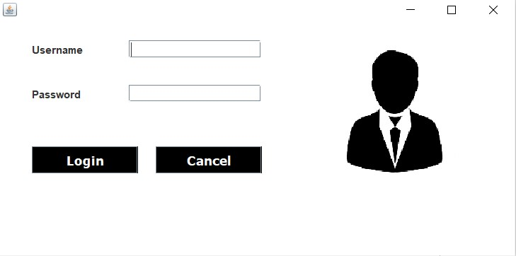
Login Form: This page represents the first thing about our website. It leads on to the login point for its personnel; it takes up the username,password and login.
Login Form

Slide 8
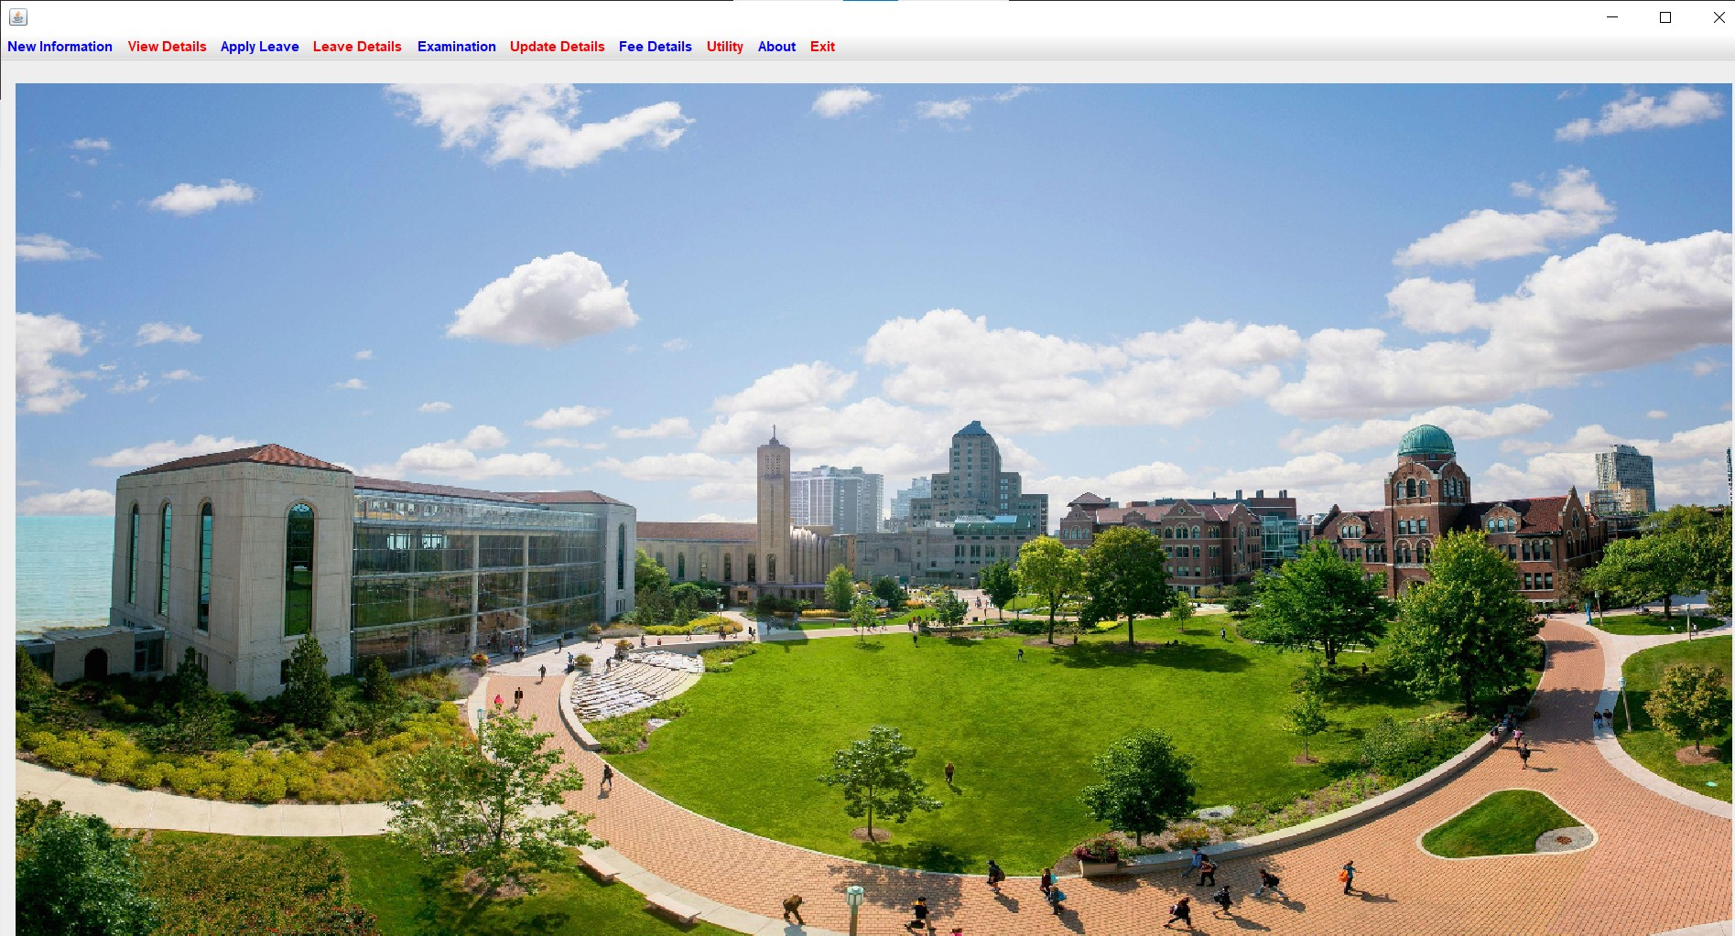
Home page user : This page shows us what user can see and access. He can add, remove,update and upload the data. He can exit from system.
Home page user

Slide 9
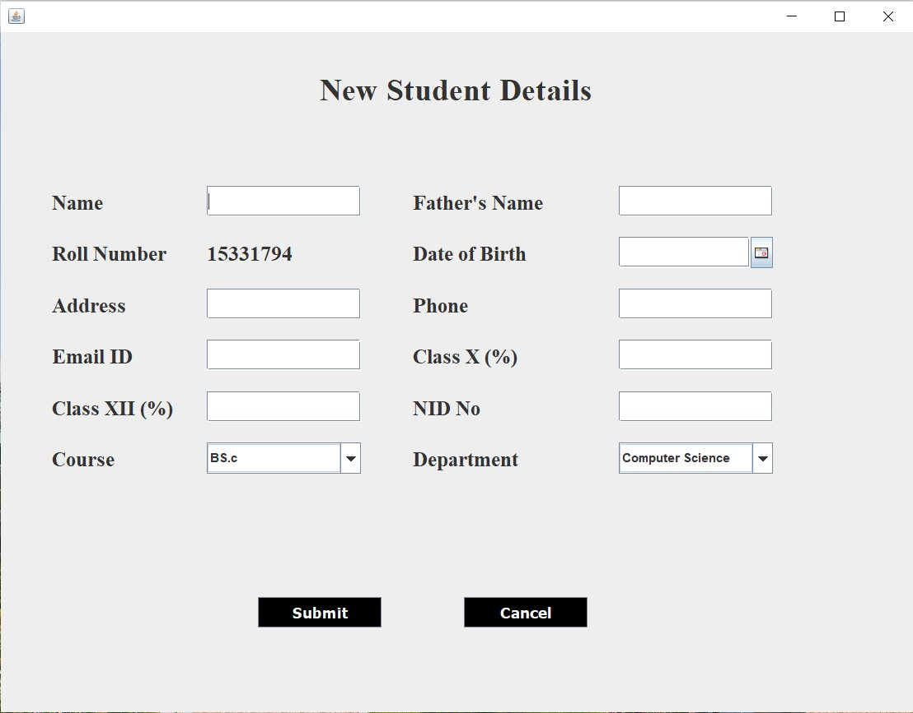
Student form : In this we can add the new student details which will be stored in back end of user.This details further can update in the update page.
Student form

Slide 10
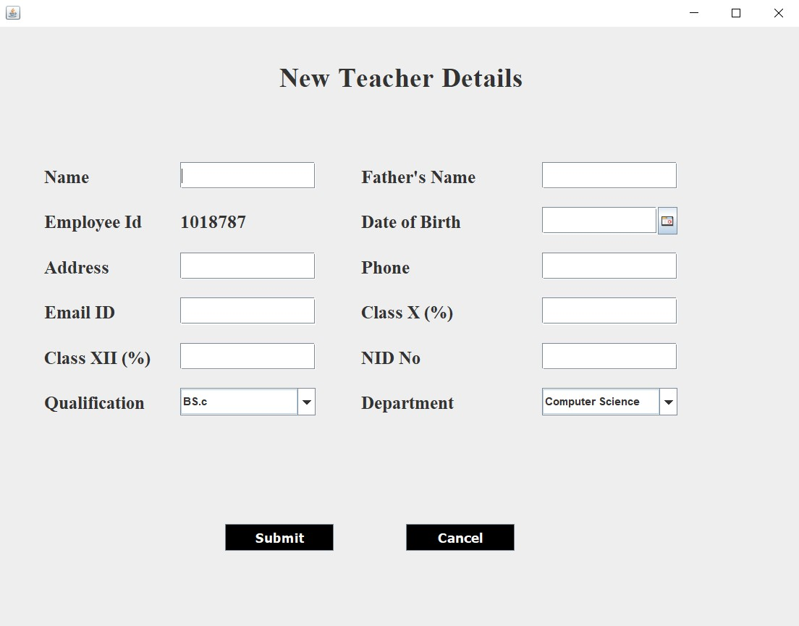
Teacher form: In this we can add the new teacher details which will be stored in back end of user.This details further can update in the update page.
Teacher form

Slide 11
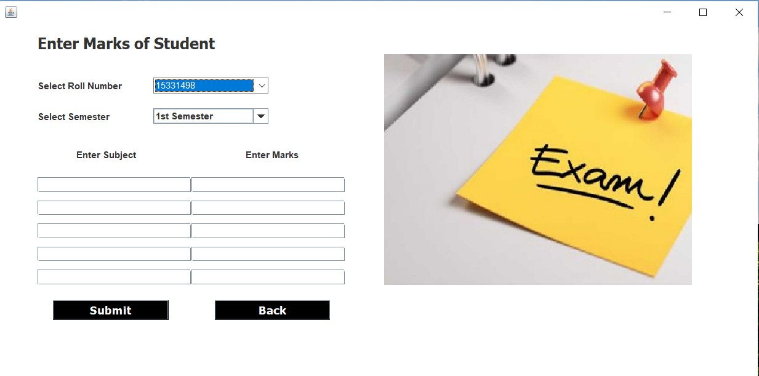
Marks and Subject page : In this page we can enter the subjects and marks scored in that particular subject along the rollno.
Marks and Subject page

Slide 12

Fee payment page: In this page we can the pay the fee dues of the particular student which uses rollno,course,department and semester to pay the fee.
Fee payment page

Slide 13
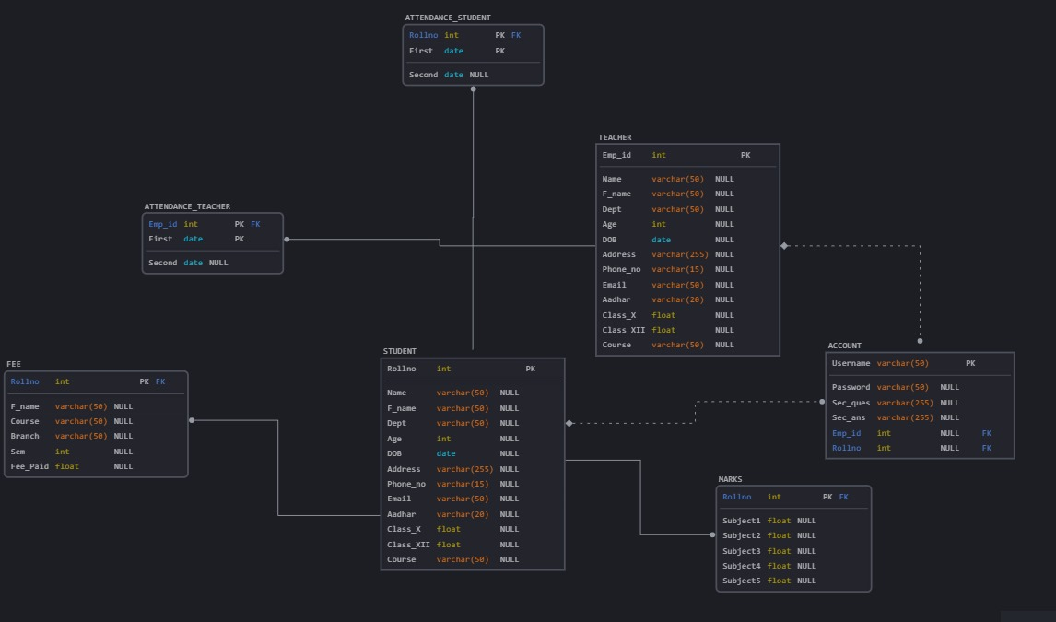
Database Design

Slide 14
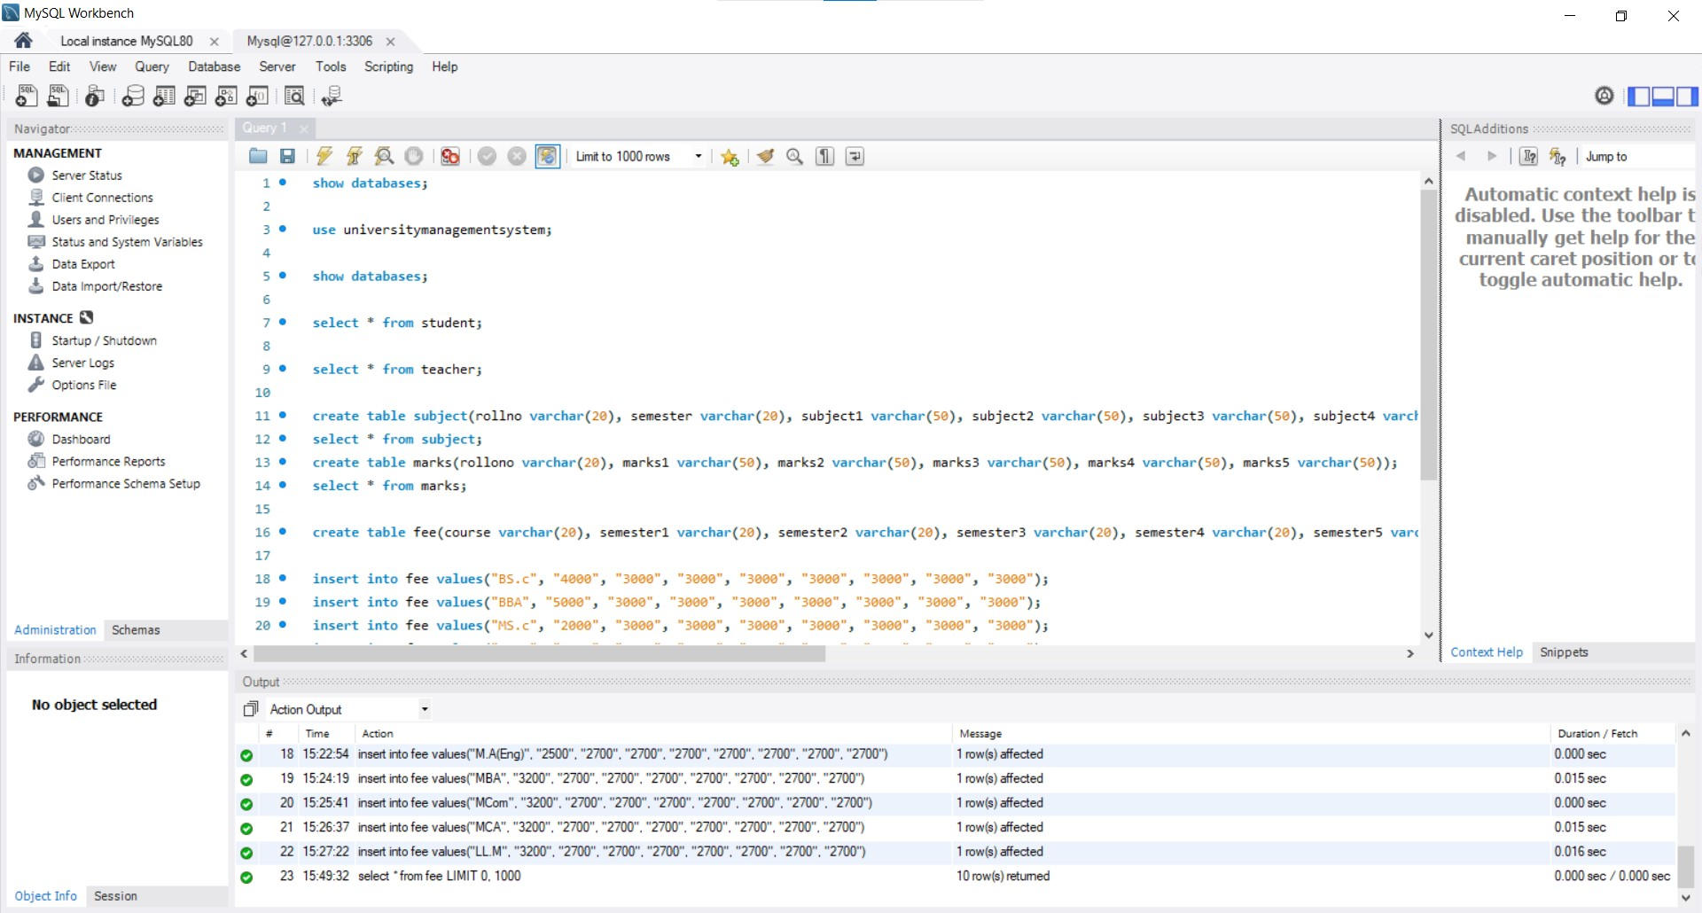
Database

Slide 15
Conclusion
In conclusion, the University Management System (UMS) desktop-based Application provides an efficient, secure, and customizable solution for managing various administrative, academic, and operational tasks within a university. With features like student enrollment, Result check, fee tracking, the system enhances workflow efficiency, reduces manual errors, and ensures better data control. Its offline accessibility, performance advantages, and cost-effectiveness make it an ideal choice for universities looking to improve internal processes and overall functionality.

